Slide 1

Training Workshop
Session 3: Meshing

Slide 2
ABAQUS Tutorial
Dynamic &
Contact FEA
Postprocessing
ABAQUS
Material &
Section Properties
Job Processing
(Solver)
Part module
Sketch module
Assembly module
Partition toolset
Loading &
Analysis Steps
Meshing

Slide 3
ABAQUS Meshing
Feature based
Coloring indicating meshing techniques
Seeding
A variety of mesh controls
  Element shape
  Assigning Abaqus/Standard, or Abaqus/Explicit element types
  Meshing algorithm
Verifying mesh quality.
Tools for refining the mesh
Optimize the mesh base on results of analysis.
Mesh Generation
Mesh Refinement

Slide 4
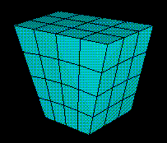
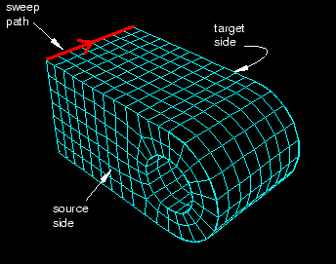
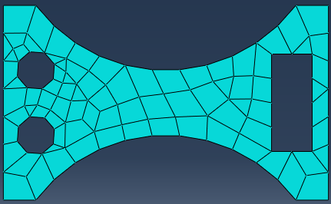
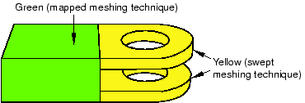
Mesh Generation
techniques
Top-down
  Structured meshing
  Swept meshing
  Free meshing
  Unmeshable meshing
Bottom-up meshing
specific topologies & geometries

Slide 5




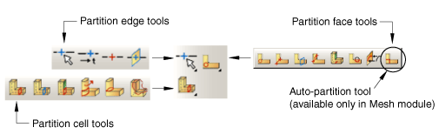
Create Geometries for Meshing
Sketch Part Assembly Partition
Step 1
Sketch a rough
approximation
Step 2
Add constraints

Slide 6
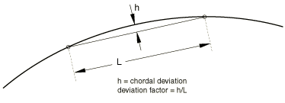
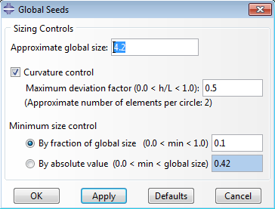
Mesh Generation
Seeding
Two kinds of seeds
Bias seeding
Curvature control
  deviation factor
  minimum size factor

Slide 7
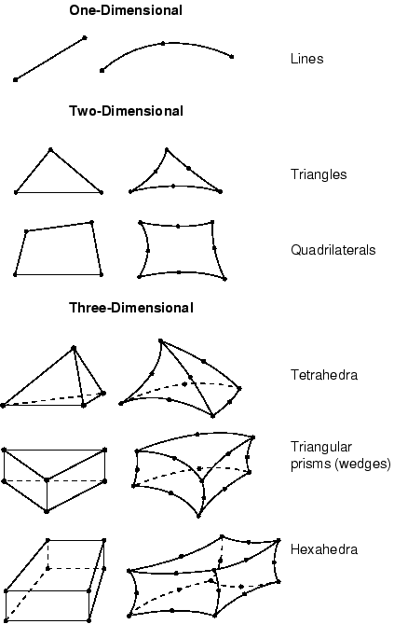
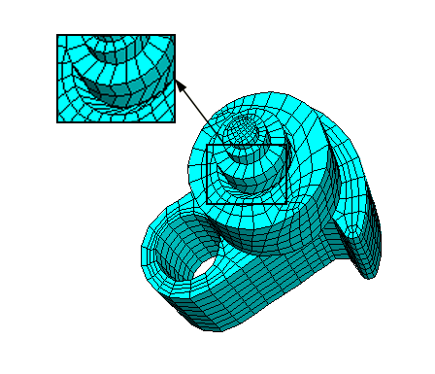
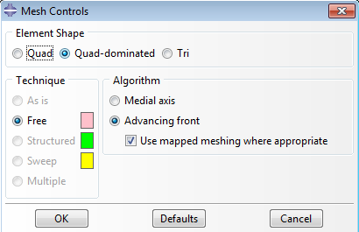
ABAQUS Meshing
Meshing Controls
  Element shape
  Meshing algorithm
    Medial axis
    Advancing front
  Element types

Slide 8

Mesh Refinement
Verify
Selection criterion | Quadrilateral | Triangle | Hexahedra | Tetrahedra | Wedge
Shape factor | N/A | 0.01 | N/A | 0.0001 | N/A
Smaller face corner angle | 10 | 5 | 10 | 5 | 10
Larger face corner angle | 160 | 170 | 160 | 170 | 160
Aspect ratio | 10 | 10 | 10 | 10 | 10

Slide 9

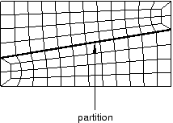
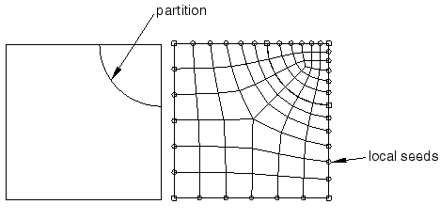
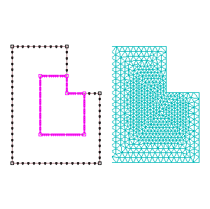
Mesh Refinement
Partition
mesh flows along the partition
Refine the mesh in the area of a stress concentration

Slide 10
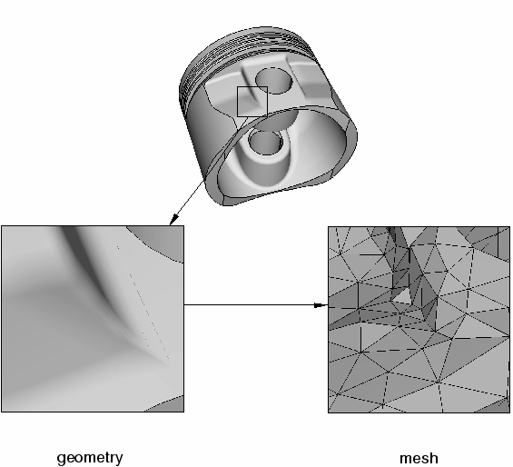
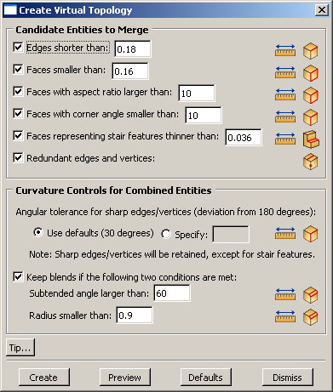
Mesh Refinement
virtual topology

